Slide 1
Kernel Methods
CSCI 4360/6360 Data Science II

Slide 2
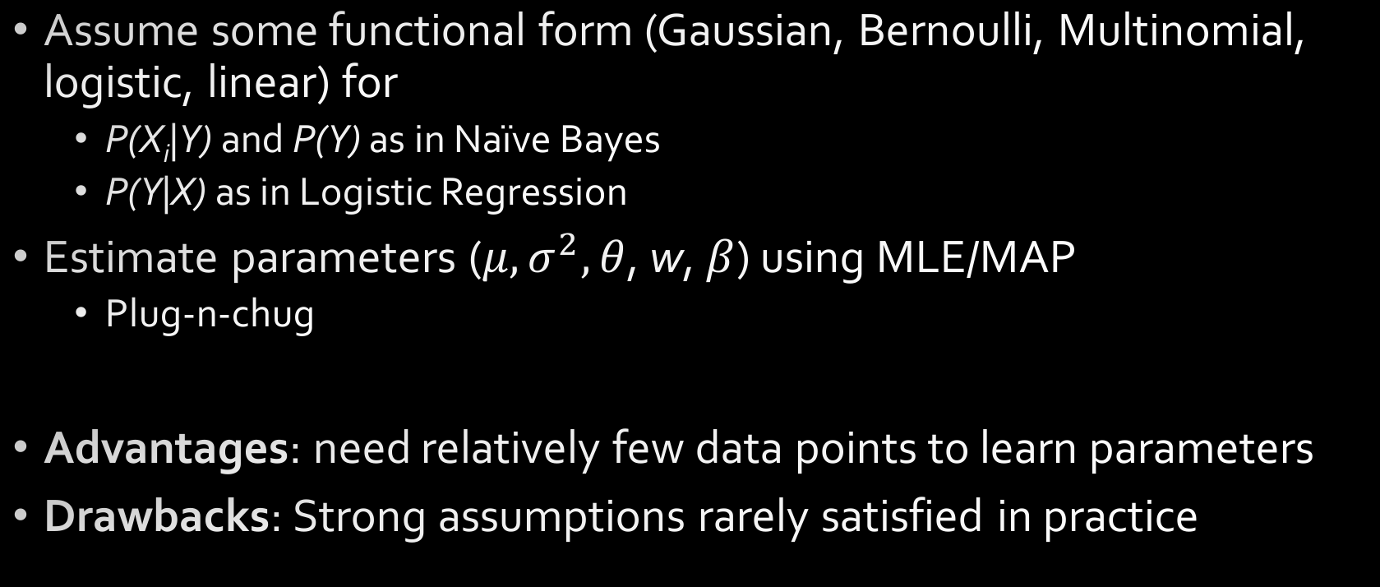
Parametric Statistics
Assume some functional form (Gaussian, Bernoulli, Multinomial, logistic, linear) for
P(X_{i}|Y) and P(Y) as in Naïve Bayes
P(Y|X) as in Logistic Regression
Estimate parameters ($μ,σ^{2},θ$, w, $β$) using MLE/MAP
Plug-n-chug
Advantages: need relatively few data points to learn parameters
Drawbacks: Strong assumptions rarely satisfied in practice

Slide 3
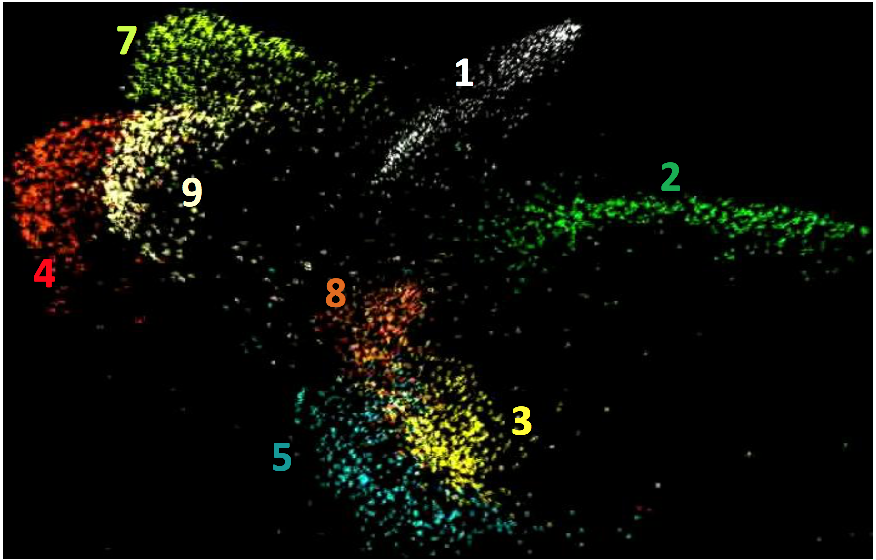
Embeddings
Again!
MNIST, projected into 2D embedding space
What distribution do these follow?
Highly nonlinear

Slide 4
Nonparametric Statistics
Typically very few, if any, distributional assumptions
Usually requires more data
Let number of parameters scale with the data
Today
Kernel density estimation
K-nearest neighbors classification
Kernel regression

Slide 5
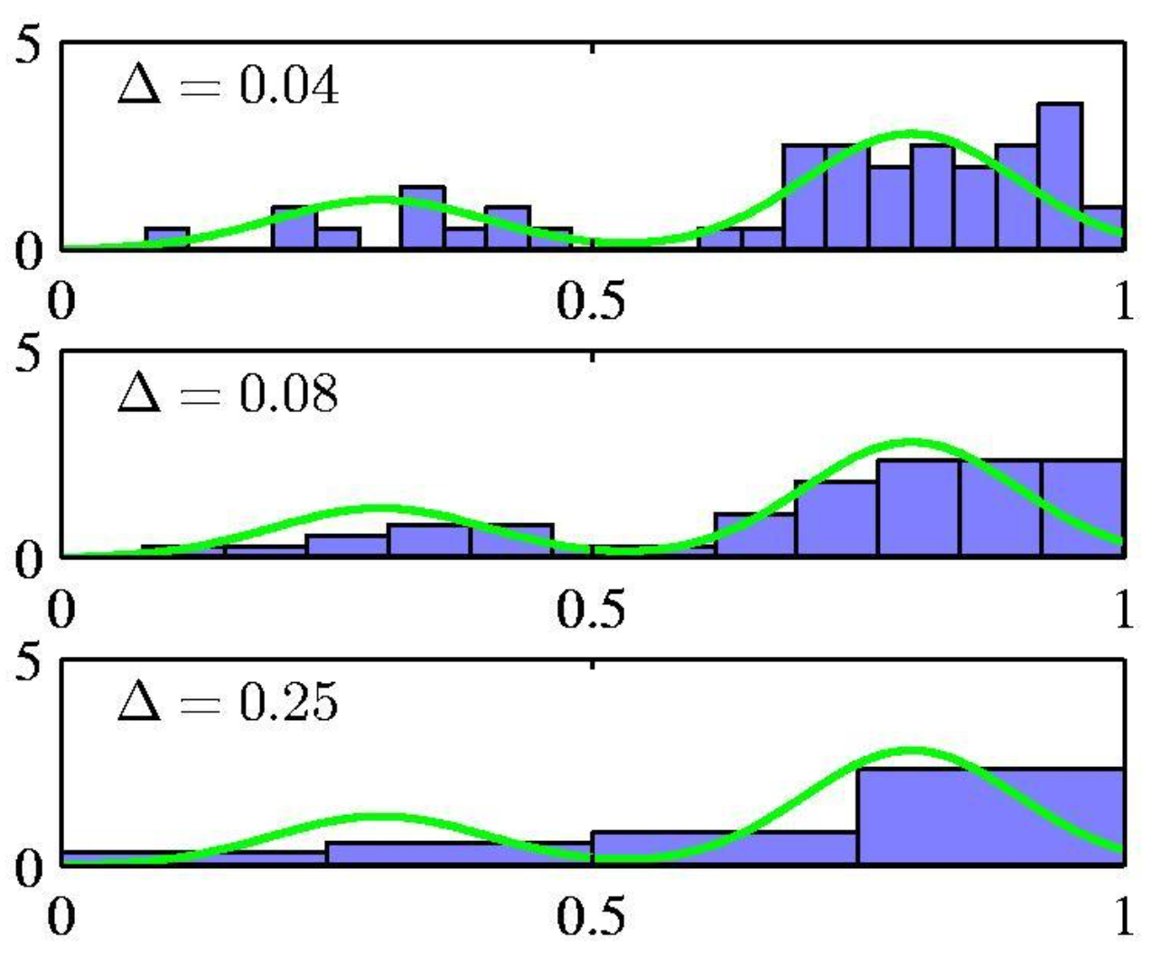

Density Estimation
You’ve done this before—histograms!
Partition feature space into distinct bins with specified widths and count number of observations n_{i} in each bin
Same width is often used for all bins
Bin width acts as smoothing parameter

Slide 6
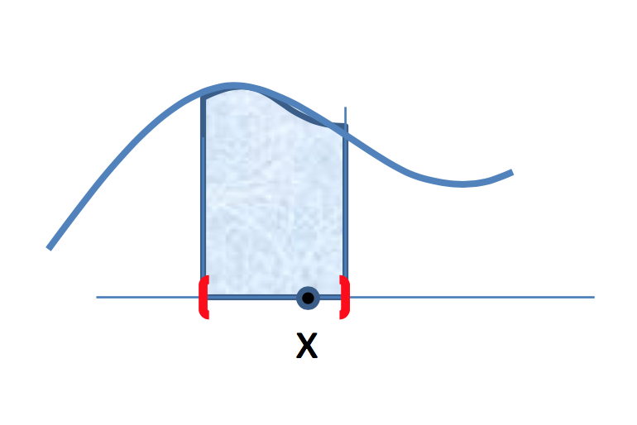

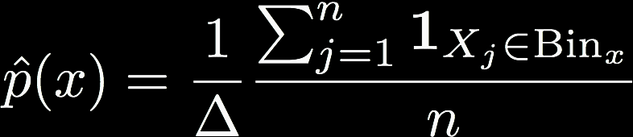
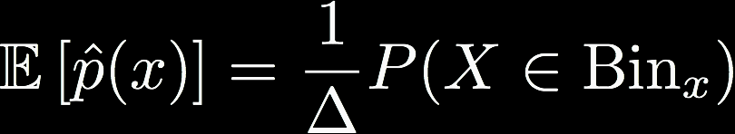


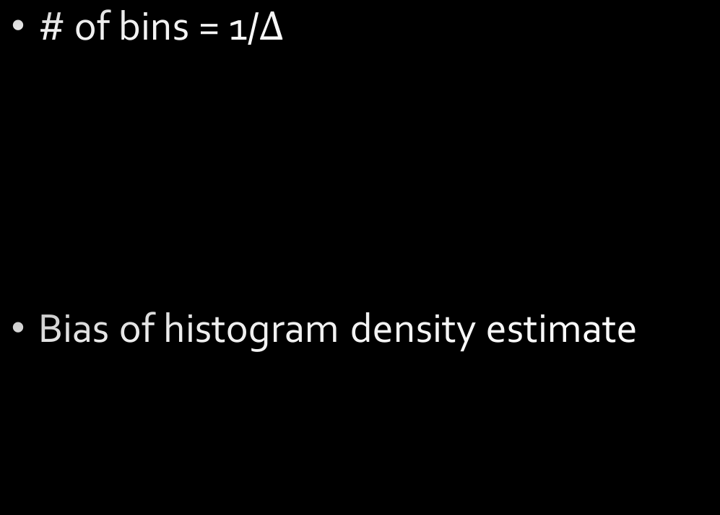
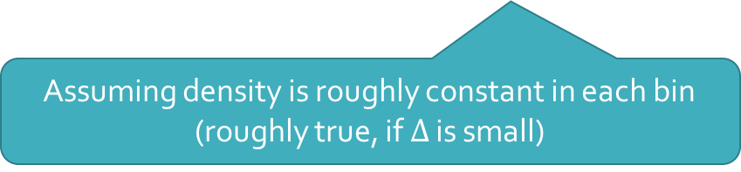

Effect of $Δ$
# of bins = 1/$Δ$
Bias of histogram density estimate
Assuming density is roughly constant in each bin (roughly true, if $Δ$ is small)

Slide 7


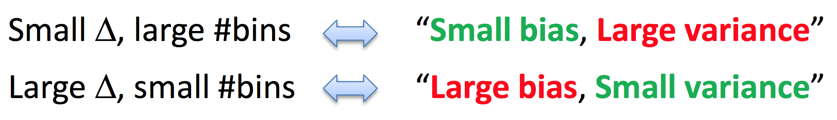
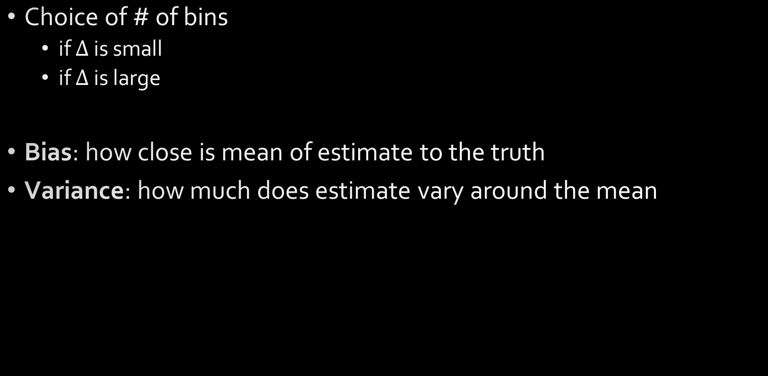
Bias-Variance Trade-off
p(x) approximately constant per bin
Choice of # of bins
if $Δ$ is small
if $Δ$ is large
Bias: how close is mean of estimate to the truth
Variance: how much does estimate vary around the mean
More data per bin stabilizes estimate

Slide 8
Bias-Variance Trade-off

Slide 9
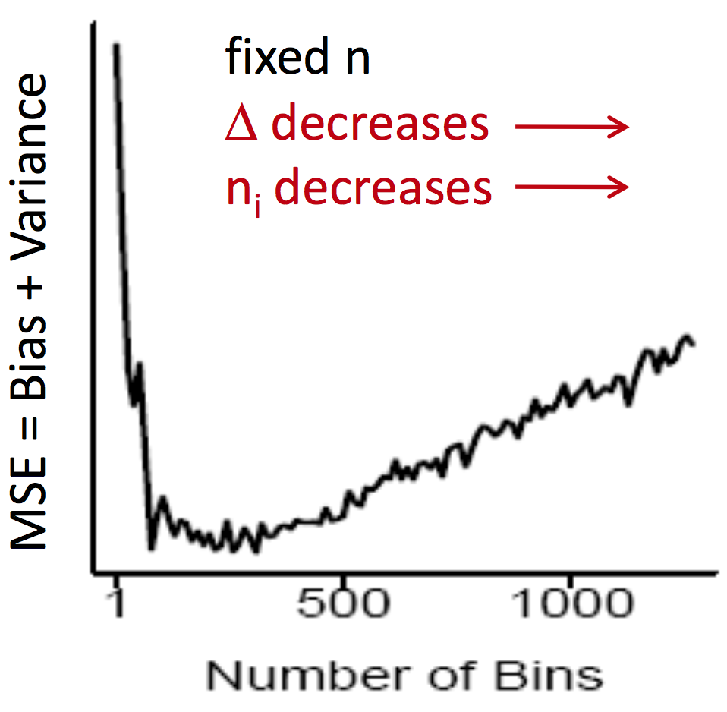
Choice of number of bins

Slide 10
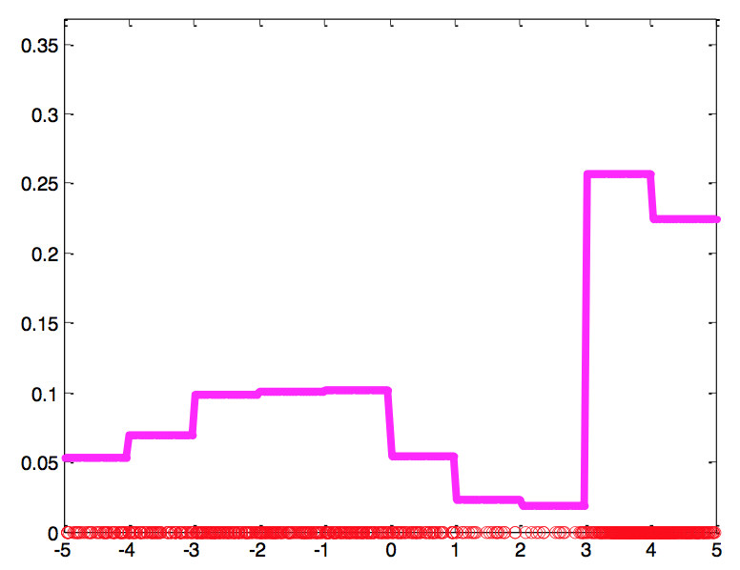
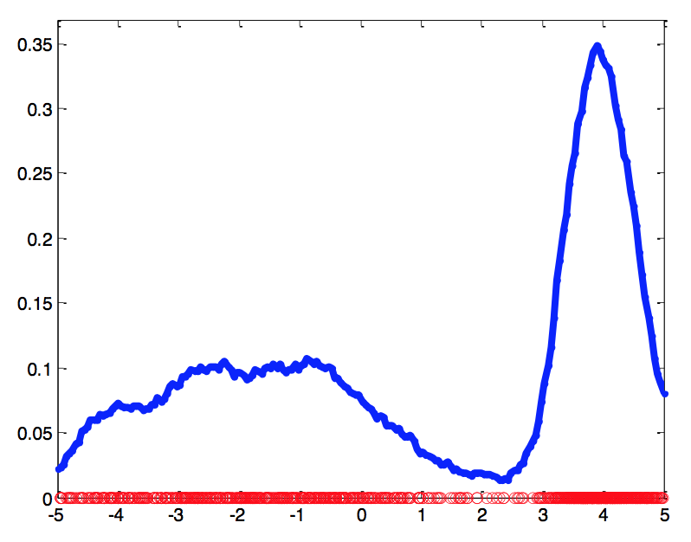
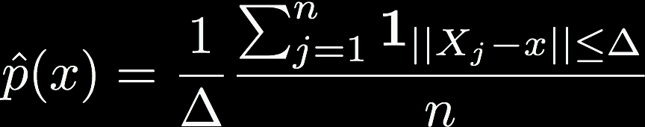
Kernel Density Estimation
Histograms are “blocky” estimates
Kernel density estimate, aka “Parzen / moving window” method

Slide 11
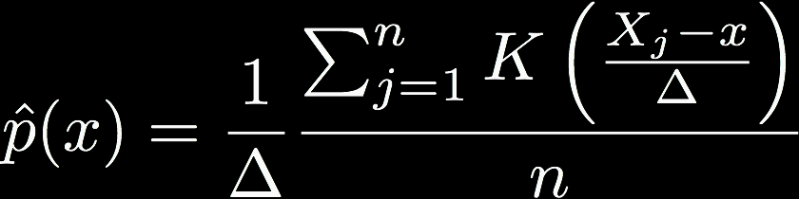
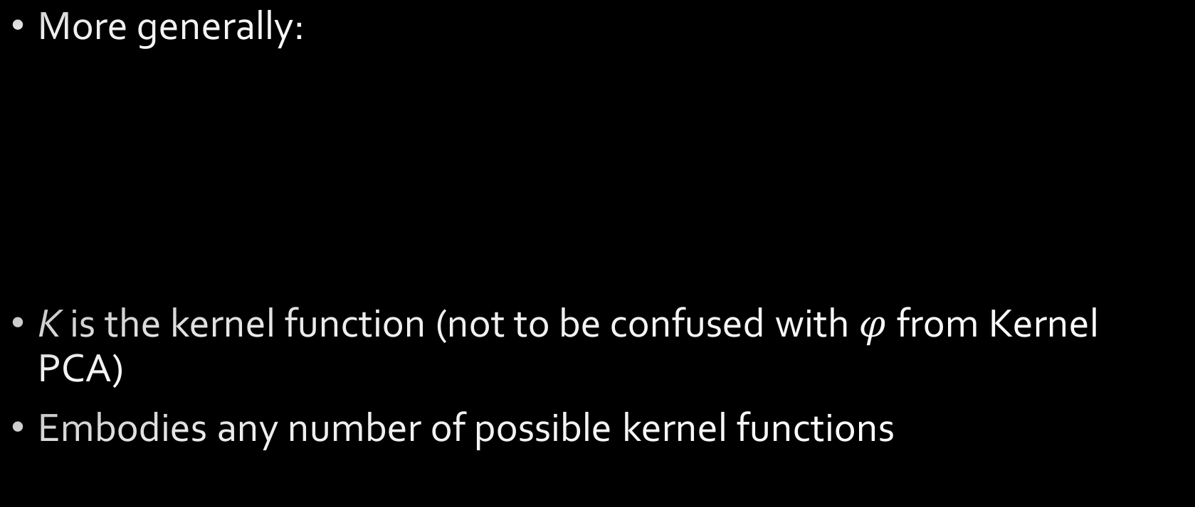
Kernel Density Estimation
More generally:
K is the kernel function (not to be confused with $φ$ from Kernel PCA)
Embodies any number of possible kernel functions

Slide 12
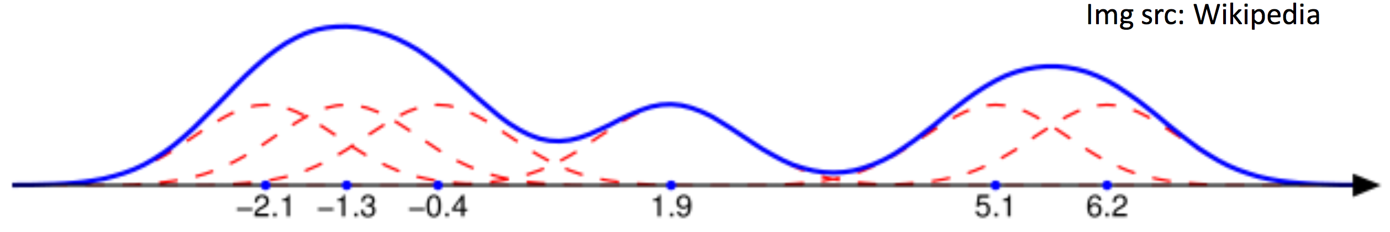
Kernel Density Estimation
Places small “bumps” at each data point, determined by K
Estimator itself consists of a [normalized] “sum of bumps”
Where points are denser, density estimate will be higher
Notes:
Gaussian bumps (red) around six data points (blue dots)—they sum to the blue curve

Slide 13
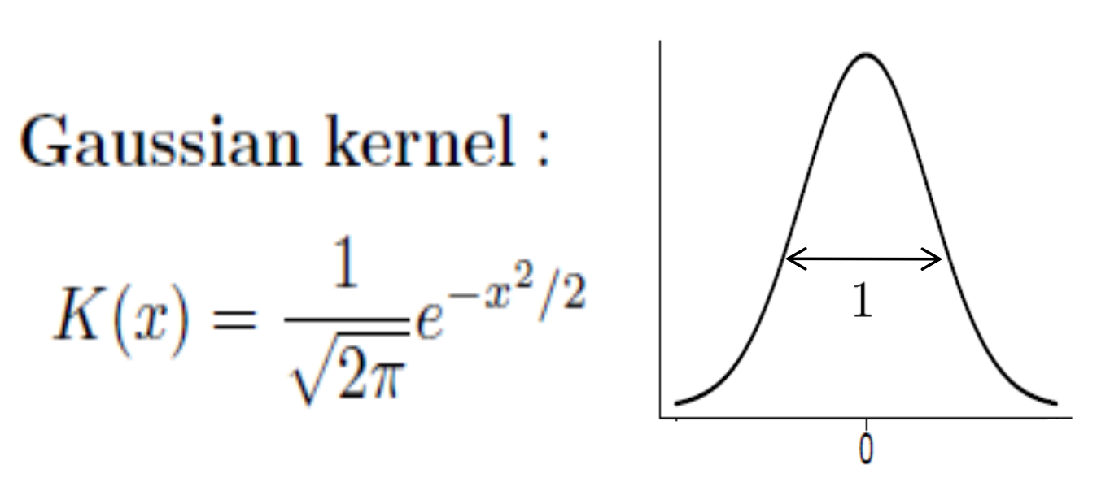
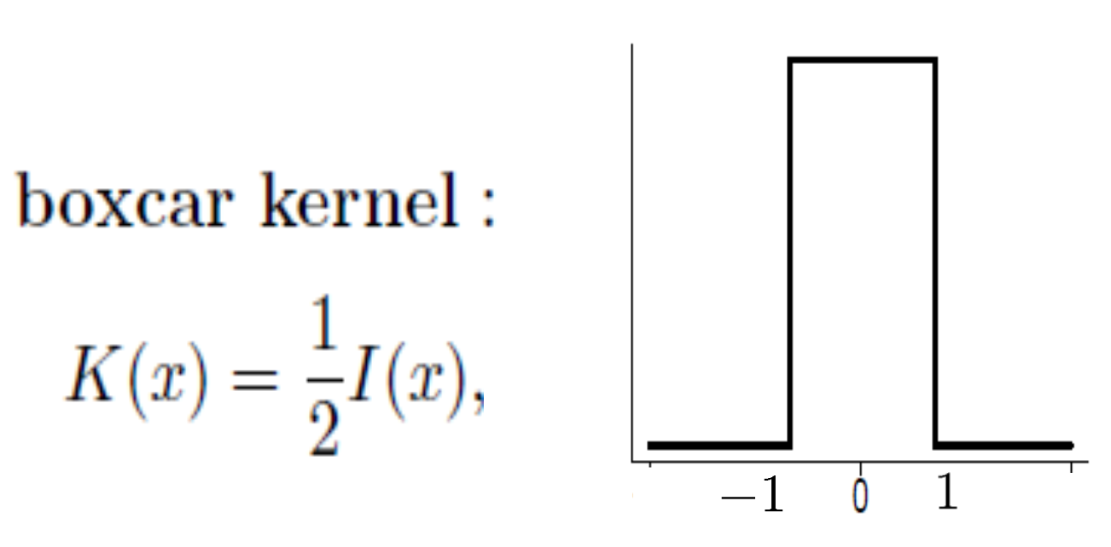
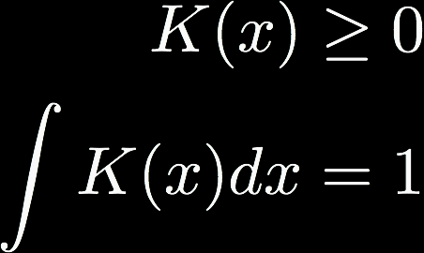
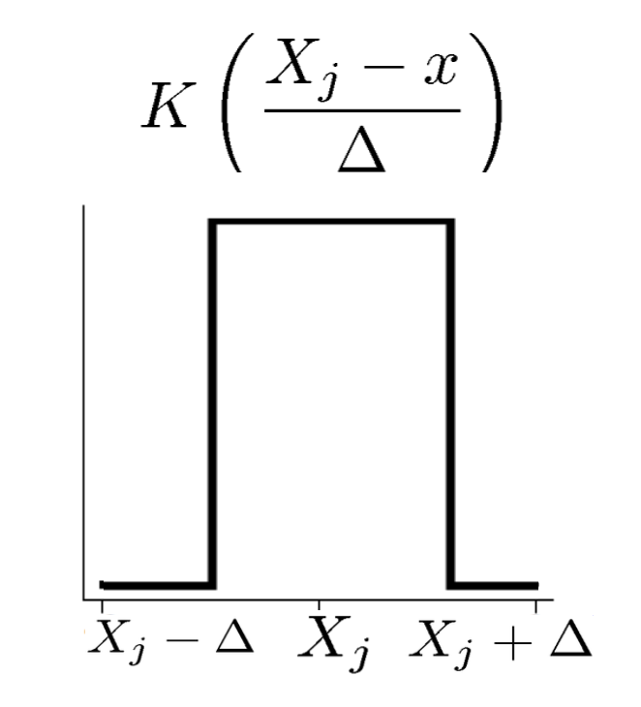
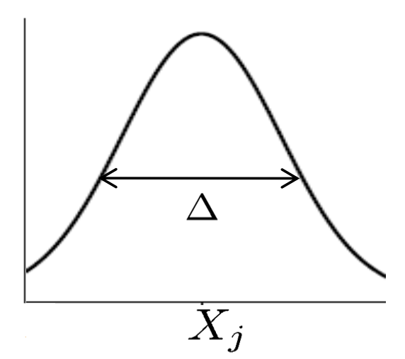
Kernels
Any function that satisfies
SciPy has a ton
See “signal.get_window”
Infinite support: need all points to compute estimate. But quite popular.
Finite support: only need local points to compute estimate

Slide 14
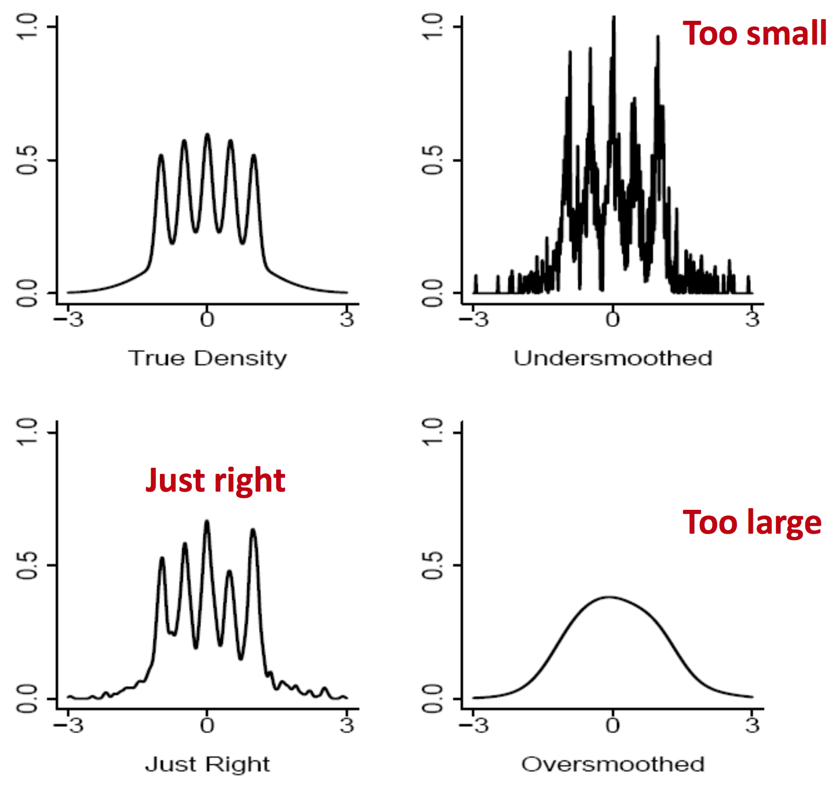
Choice of kernel bandwidth
The Bart-Simpson Density

Slide 15
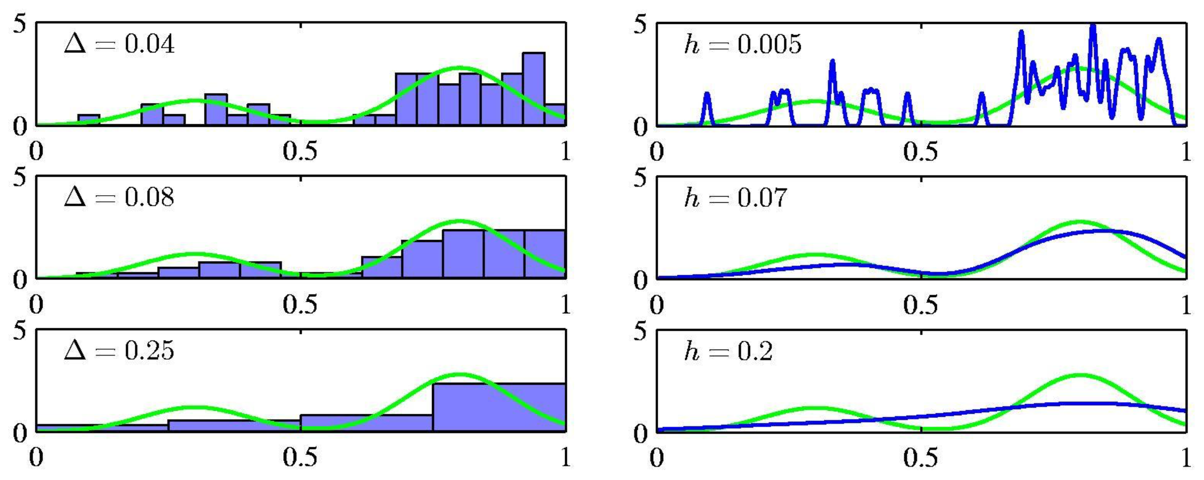
Histograms versus KDE

Slide 16
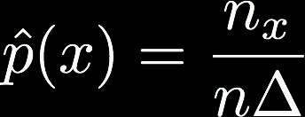
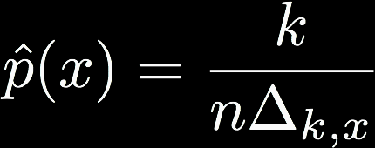
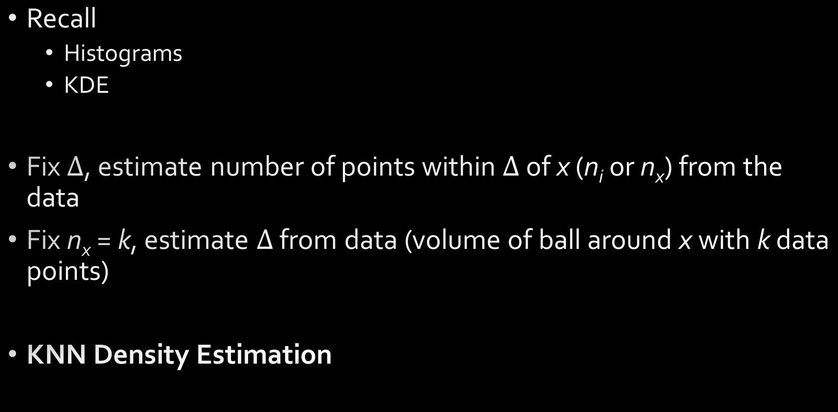
KNN Density Estimation
Recall
Histograms
KDE
Fix $Δ$, estimate number of points within $Δ$ of x (n_{i} or n_{x}) from the data
Fix n_{x} = k, estimate $Δ$ from data (volume of ball around x with k data points)
KNN Density Estimation

Slide 17
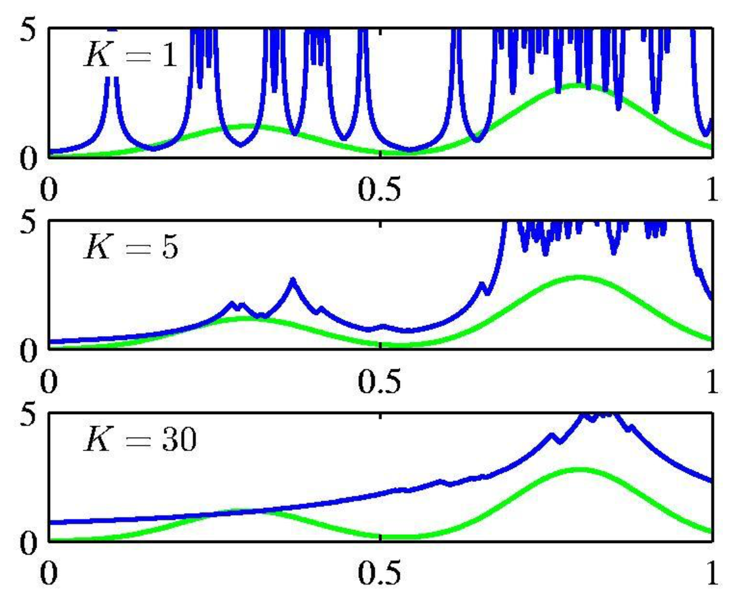
KNN Density Estimation
k acts as a smoother
Not very popular for density estimation
Computationally expensive
Estimates are poor
But related version for classification is very popular

Slide 18
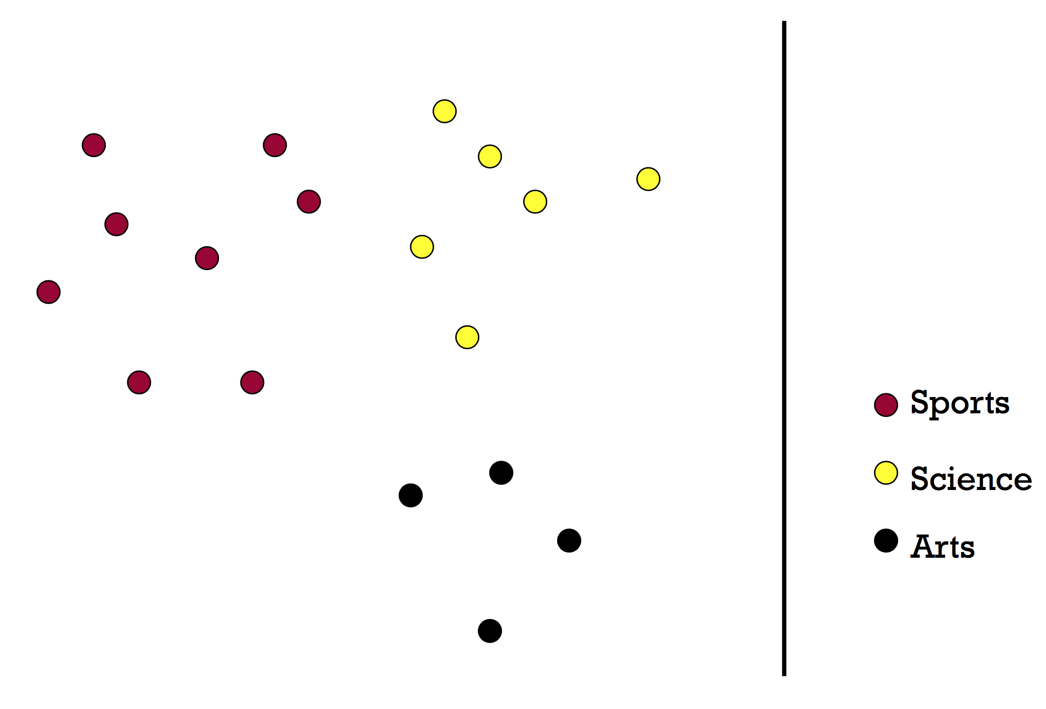
KNN Classification

Slide 19
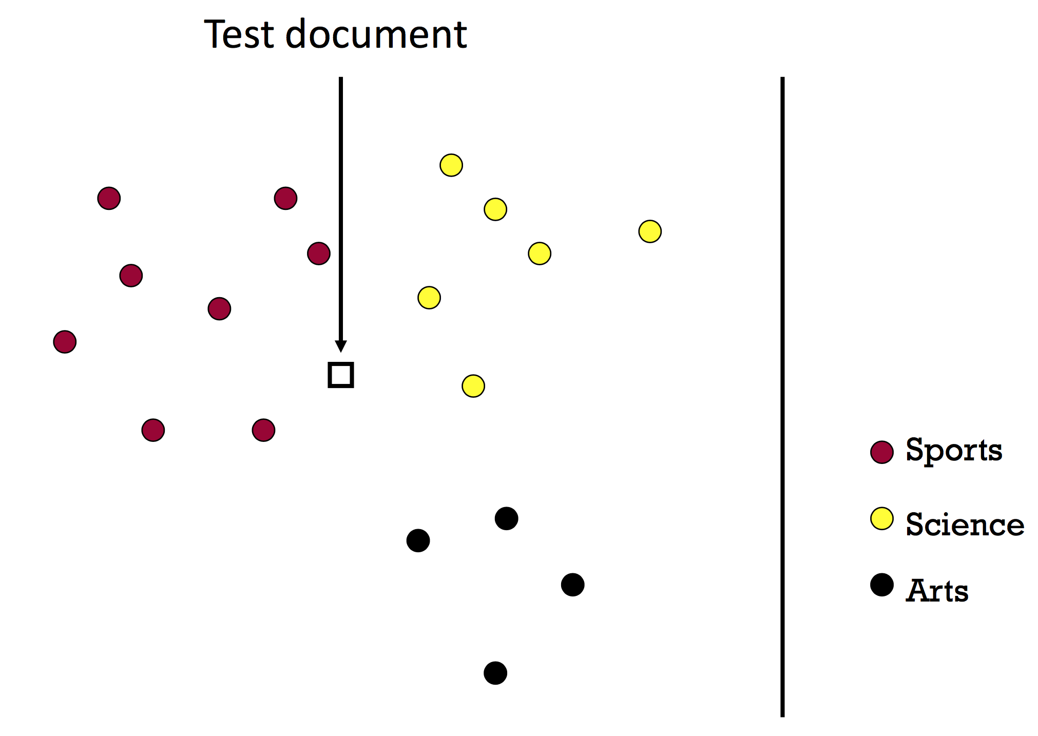
KNN Classification

Slide 20
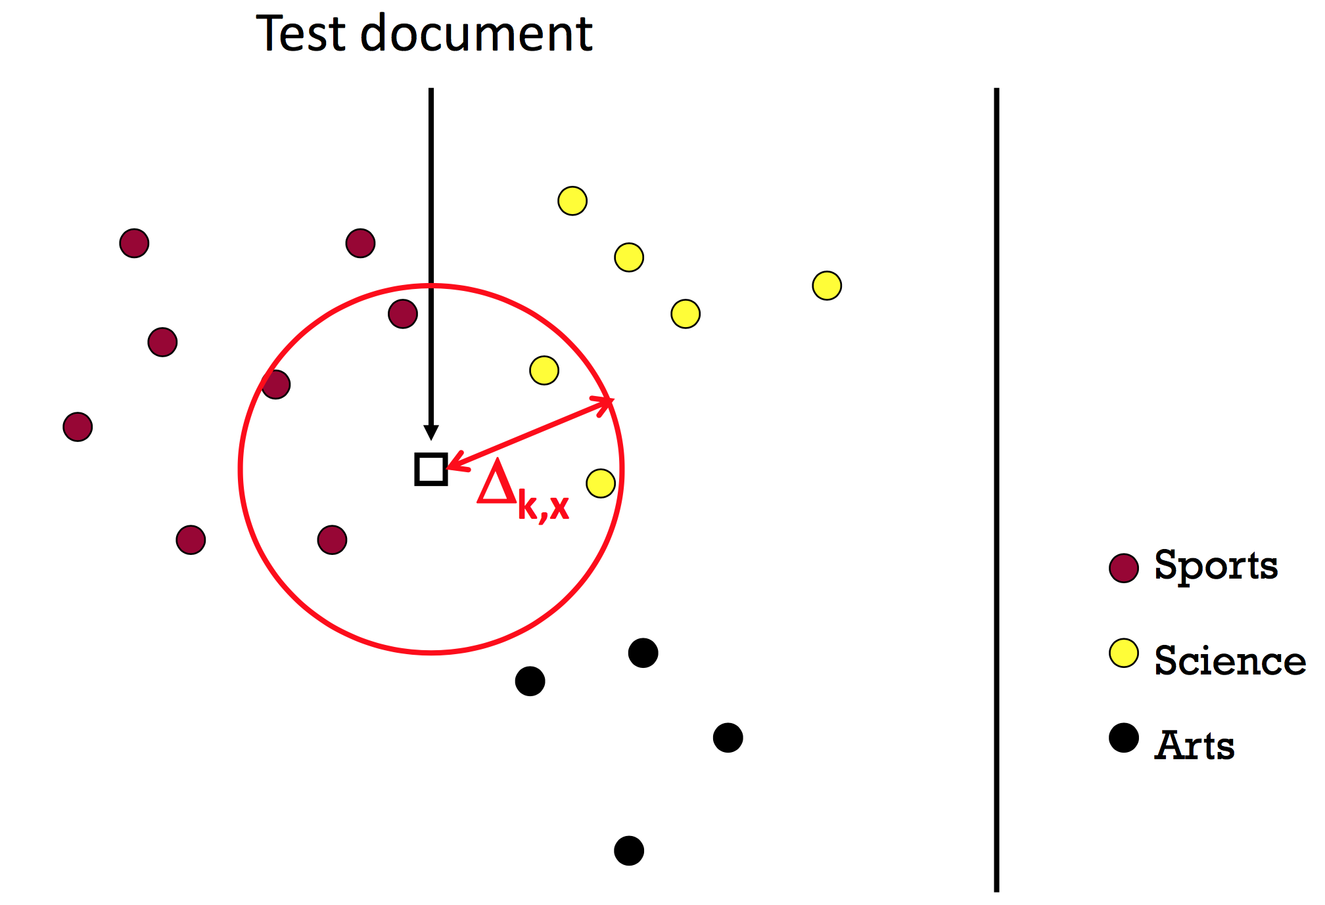
KNN Classification
k = 4
What should we predict?
Average? Majority? Why?

Slide 21


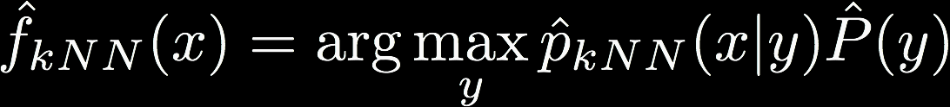



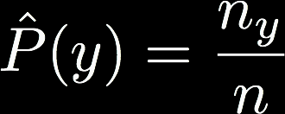

KNN Classification
Optimal classifier
KNN classifier
# of training points in class y
# of training points in class y that lie within $Δ_{k}$ball

Slide 22
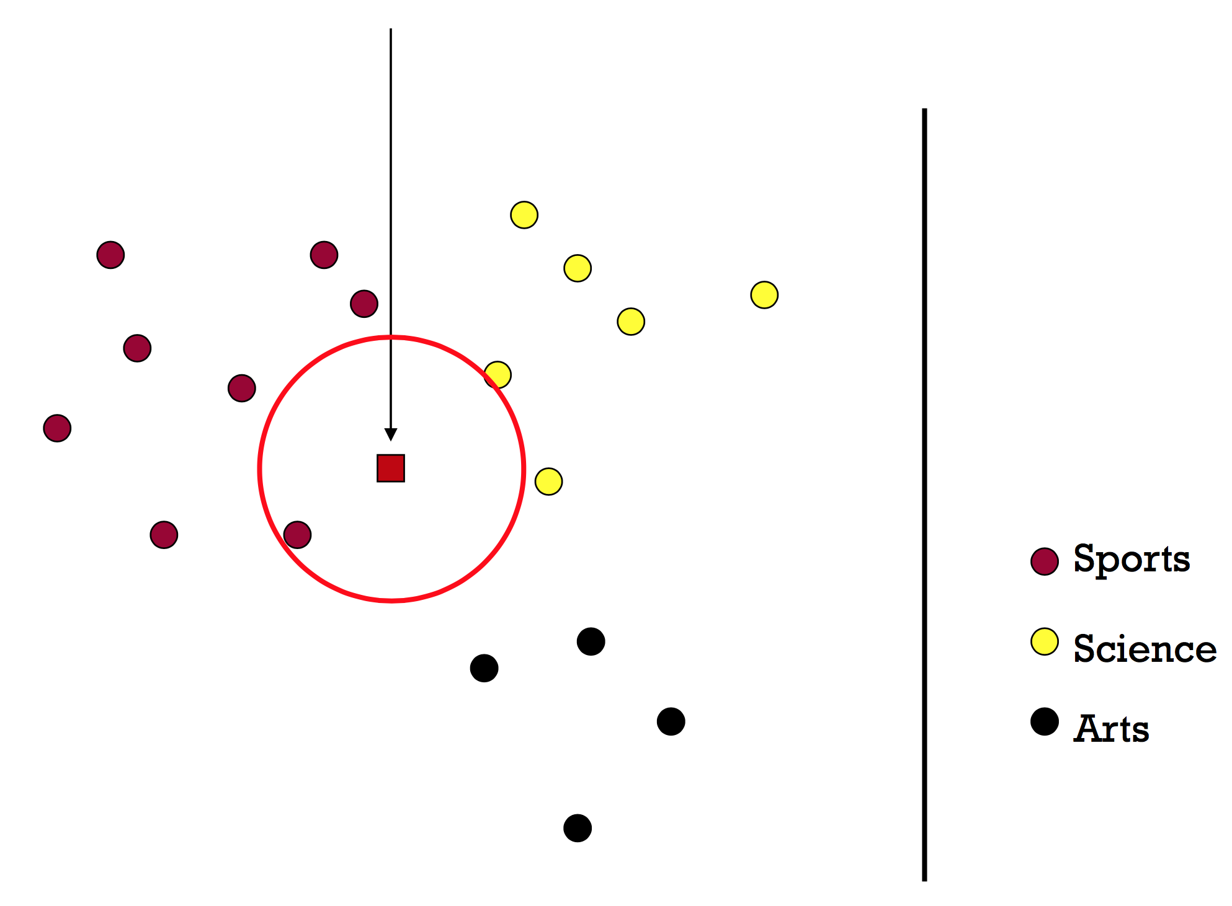
1-NN

Slide 23
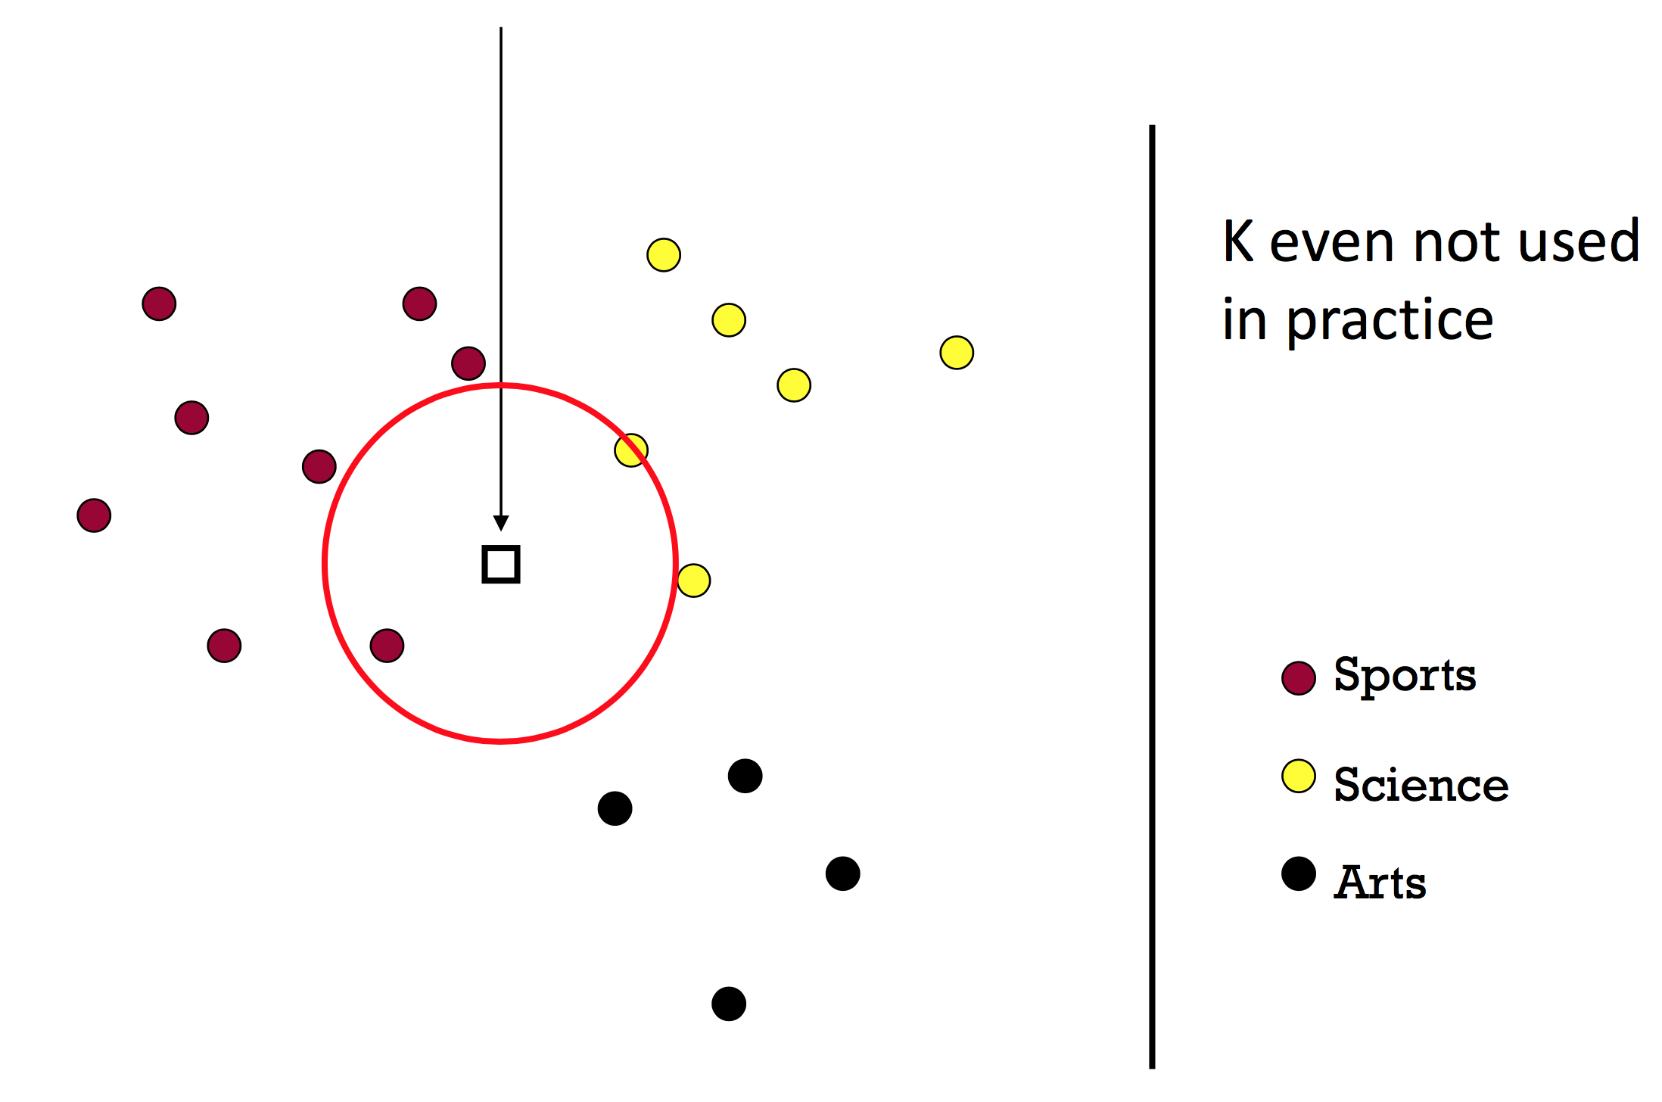
2-NN

Slide 24
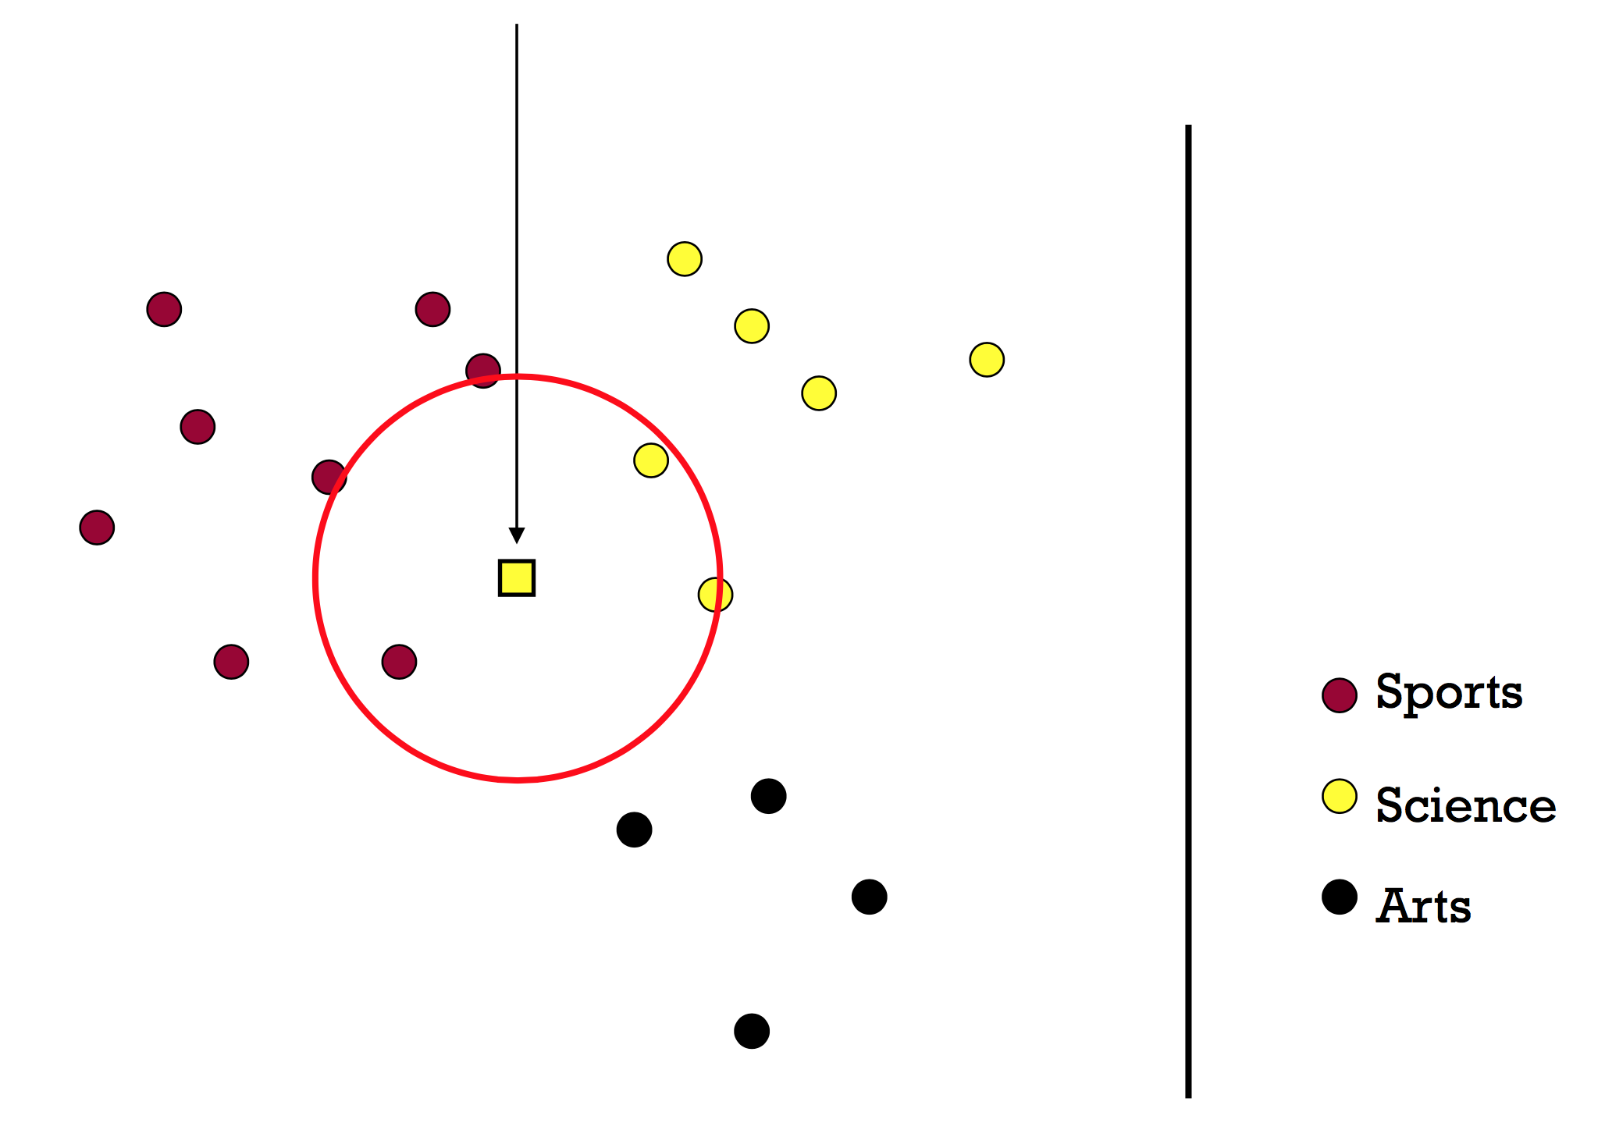
3-NN

Slide 25
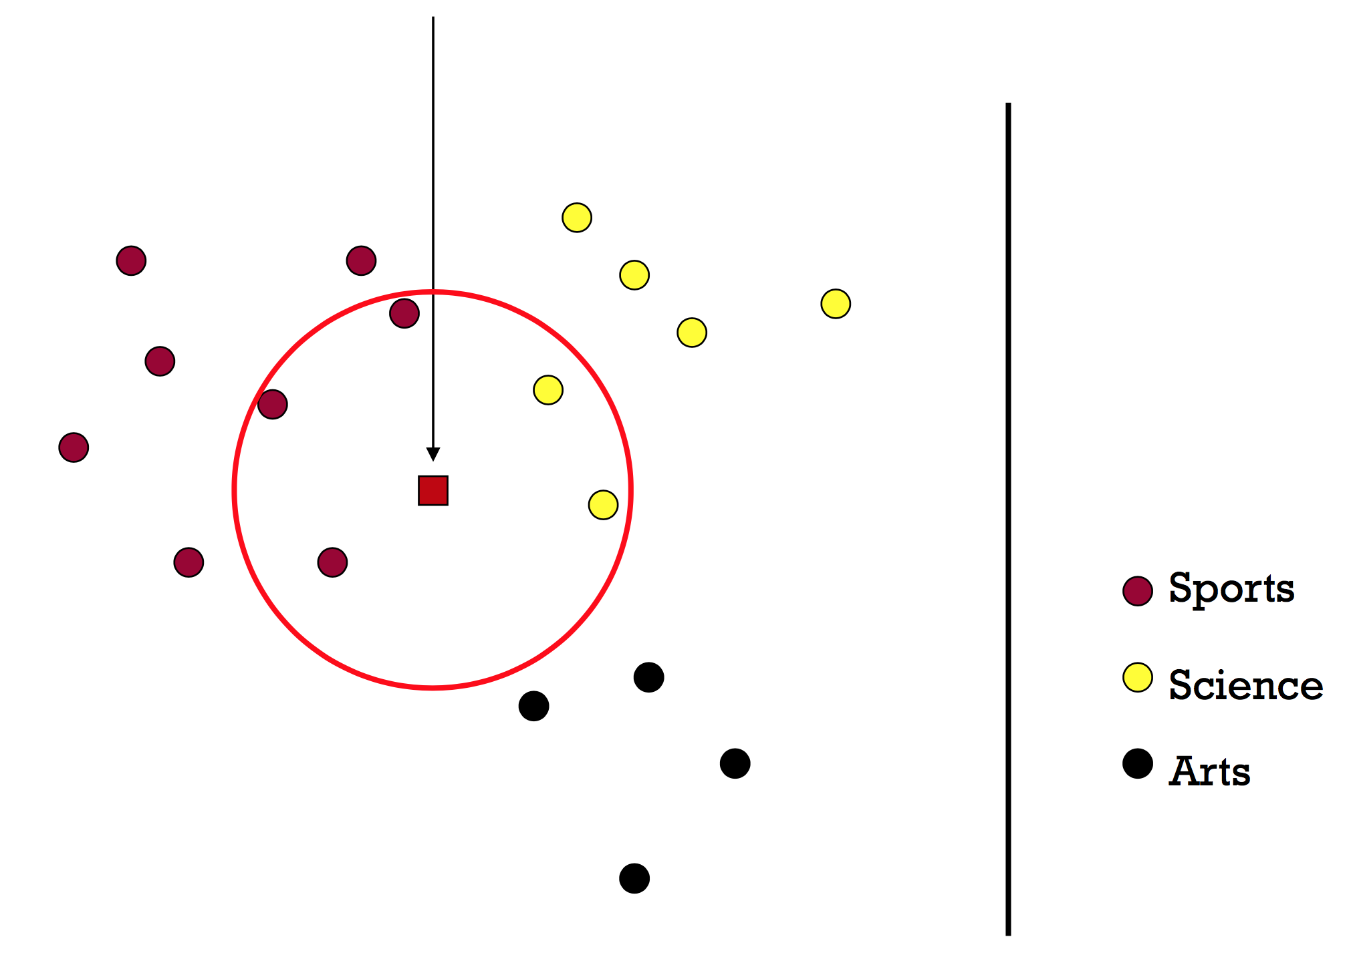
5-NN

Slide 26
What is the best k?
Bias-variance trade-off
Large k = predicted label is more stable
Small k = predicted label is more accurate
Similar to density estimation

Slide 27
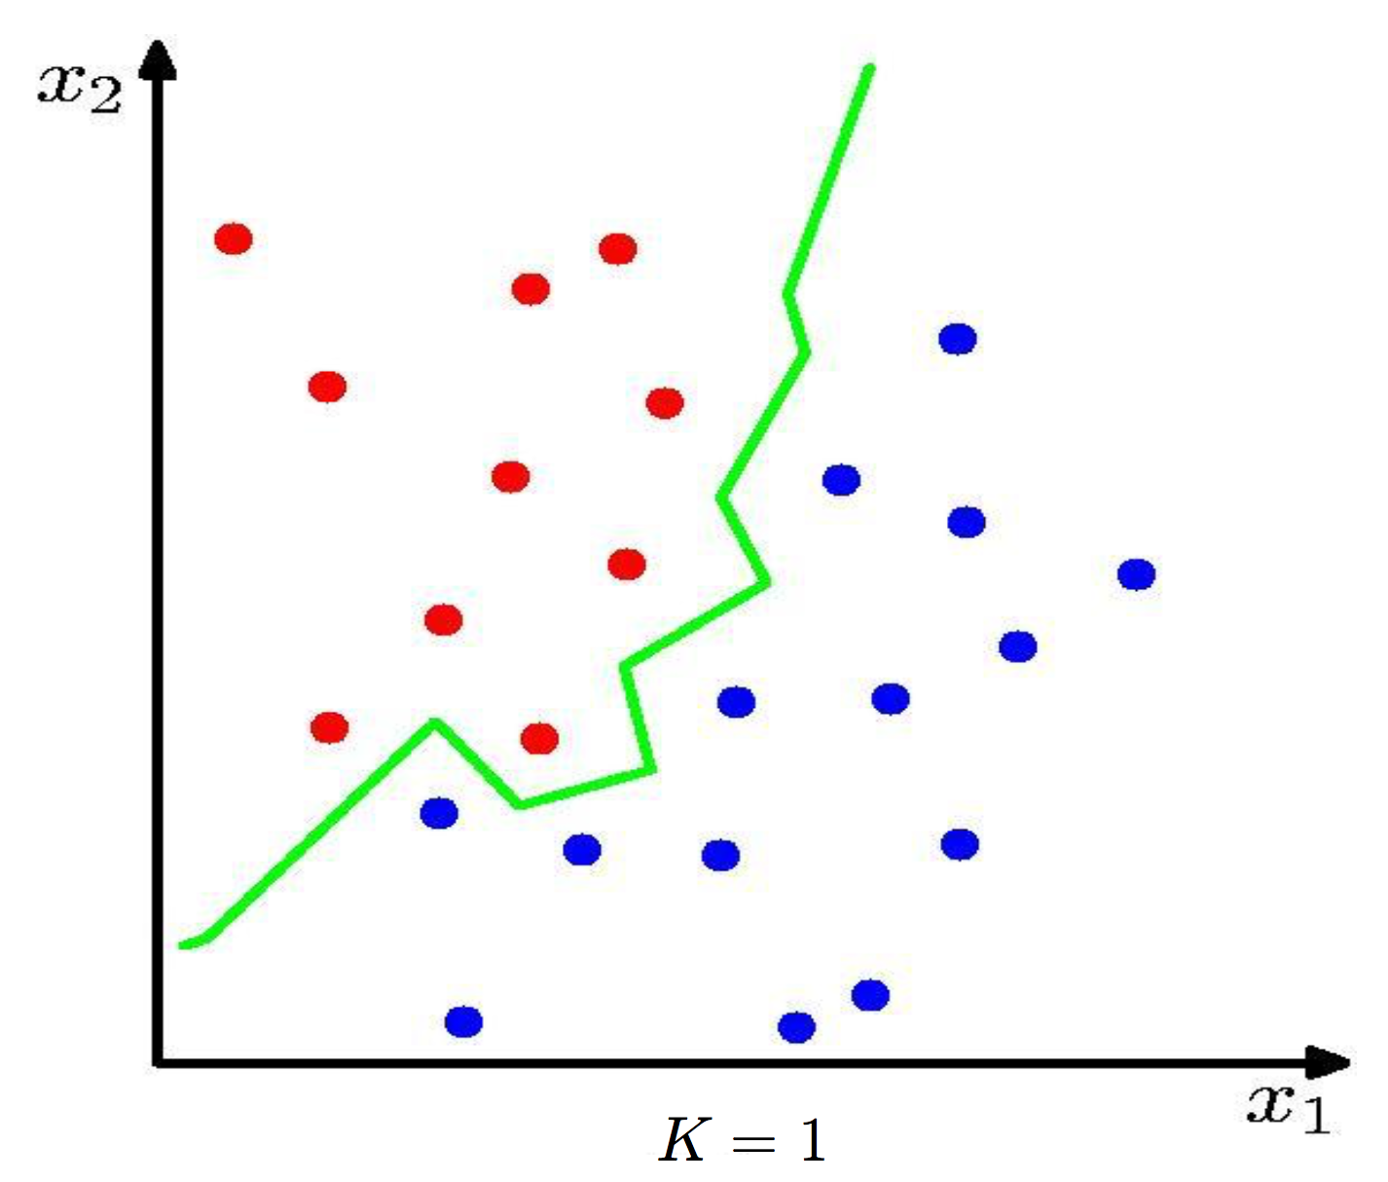
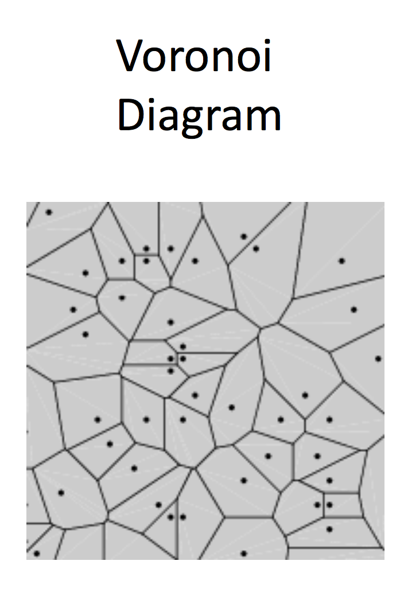
1-NN Decision Boundary

Slide 28
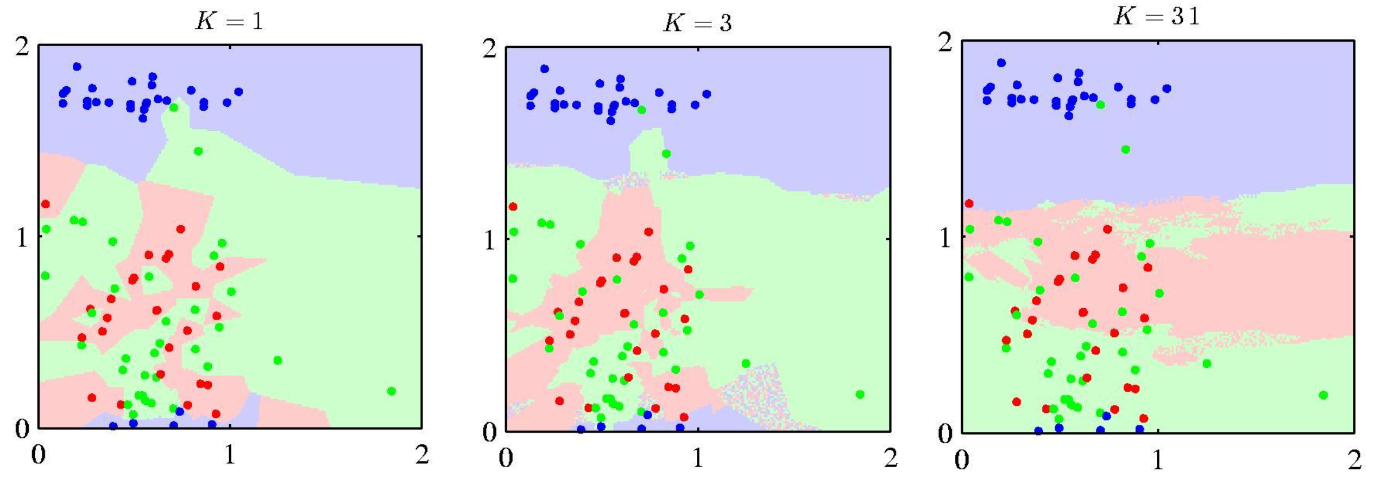
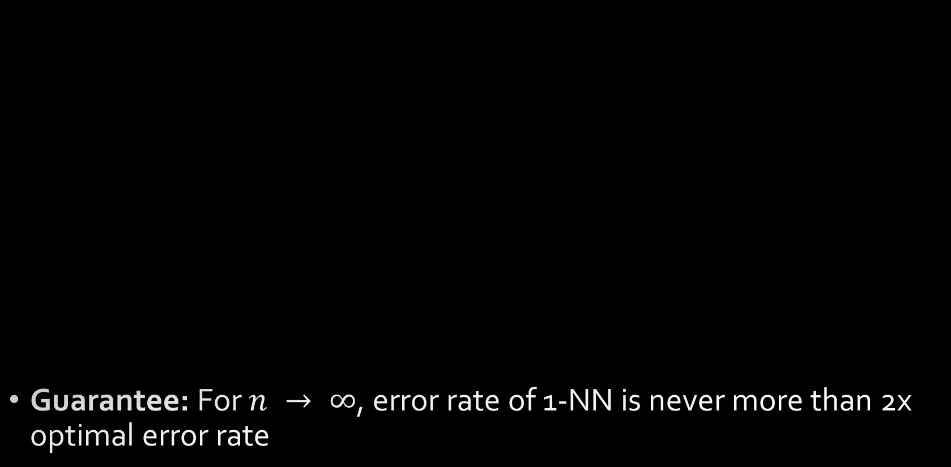
KNN Decision Boundaries
Guarantee: For $n → ∞$, error rate of 1-NN is never more than 2x optimal error rate

Slide 29
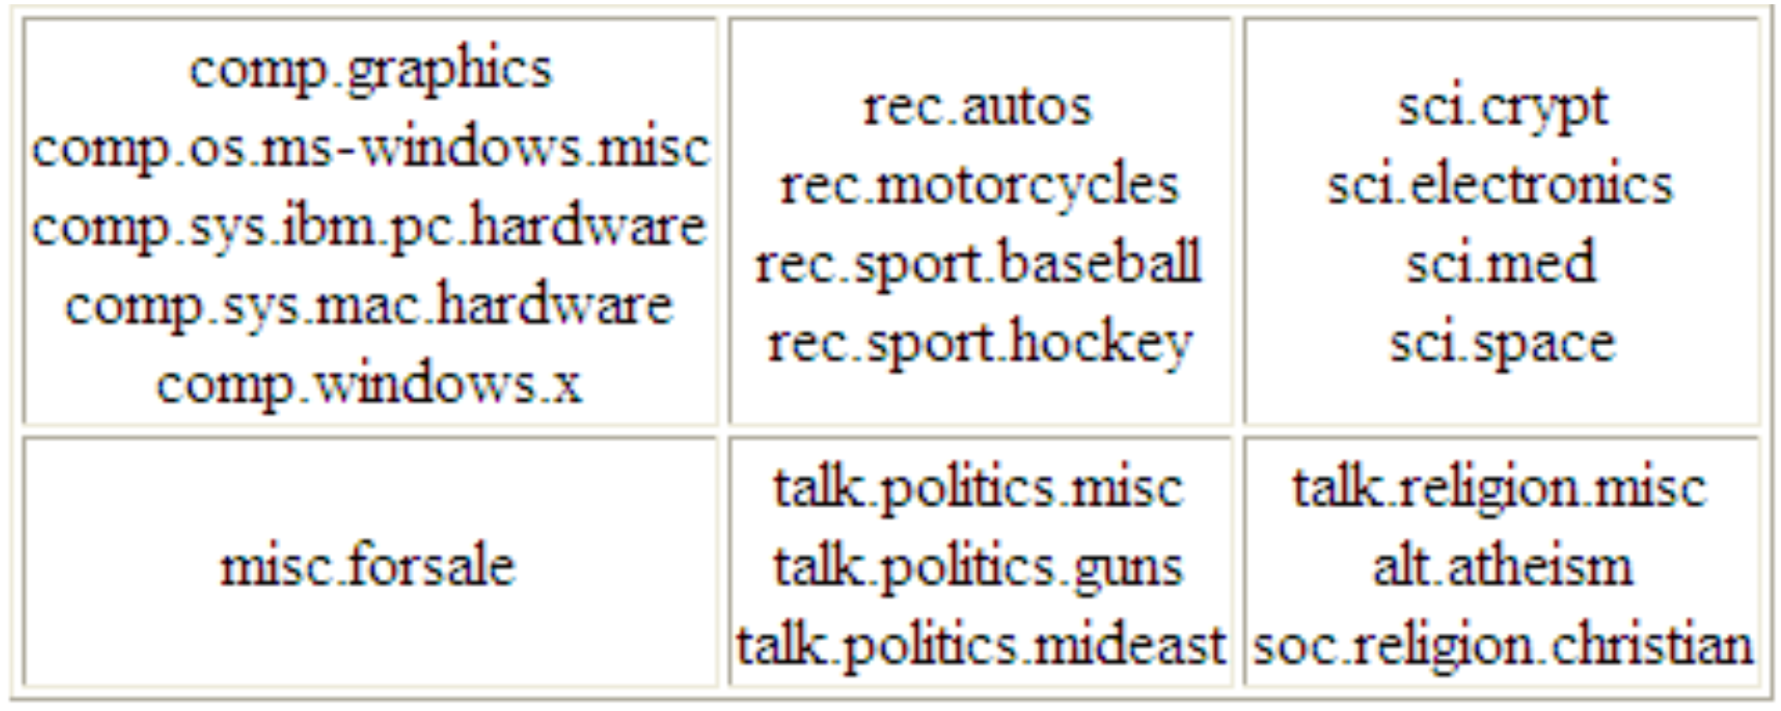
Case Study: Newsgroups Classification
20 Newsgroups
61,118 words
18,774 documents
Class label descriptions

Slide 30
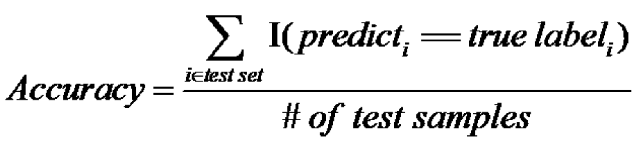
Case Study: Newsgroups Classification
Training/Testing
50%-50% randomly split
10 runs
Report average results
Evaluation Criteria

Slide 31
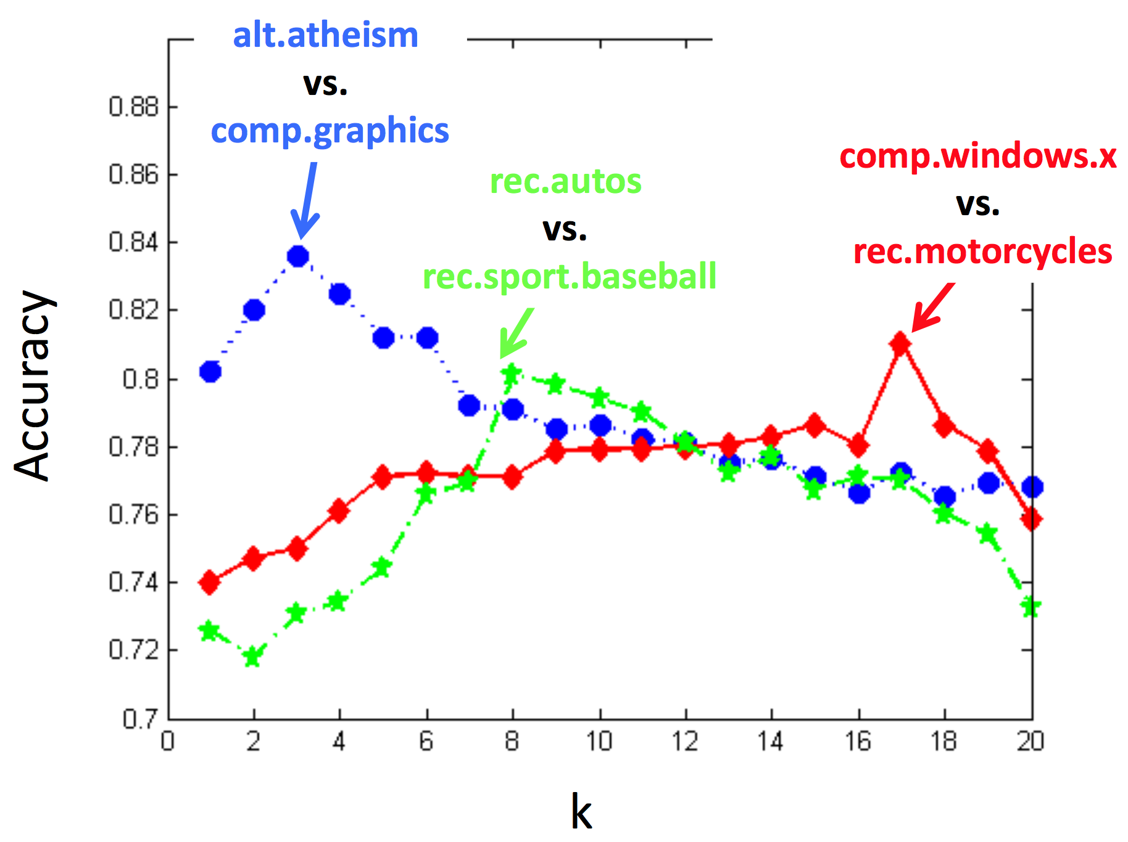
Case Study: Newsgroups Classification
Results in binary class comparisons

Slide 32
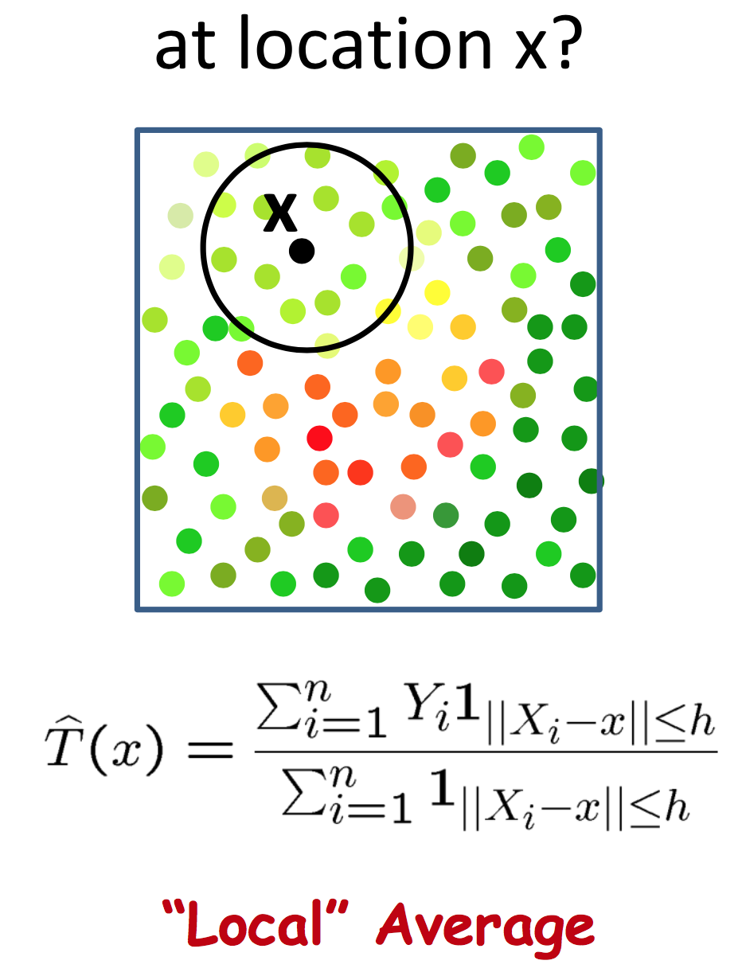
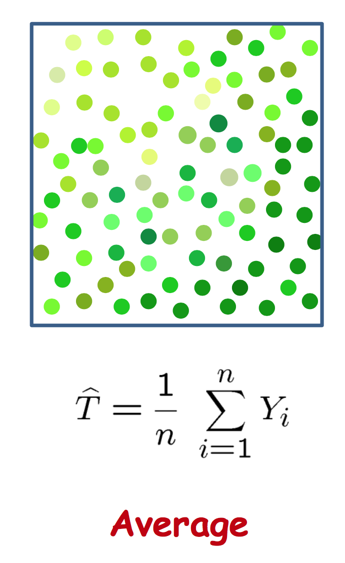
Temperature Sensing
What is the temperature in the room?

Slide 33
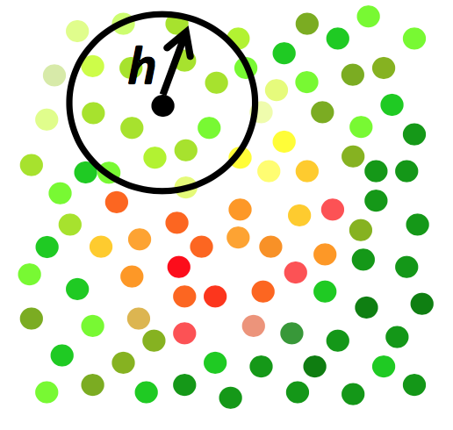
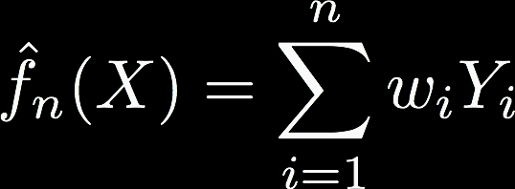
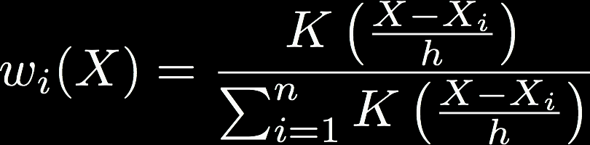
Kernel Regression
Or “local” regression
Nadaraya-Watson Kernel Estimator
Weight each training point on distance to test point
Boxcar kernel yields local average
…where

Slide 34
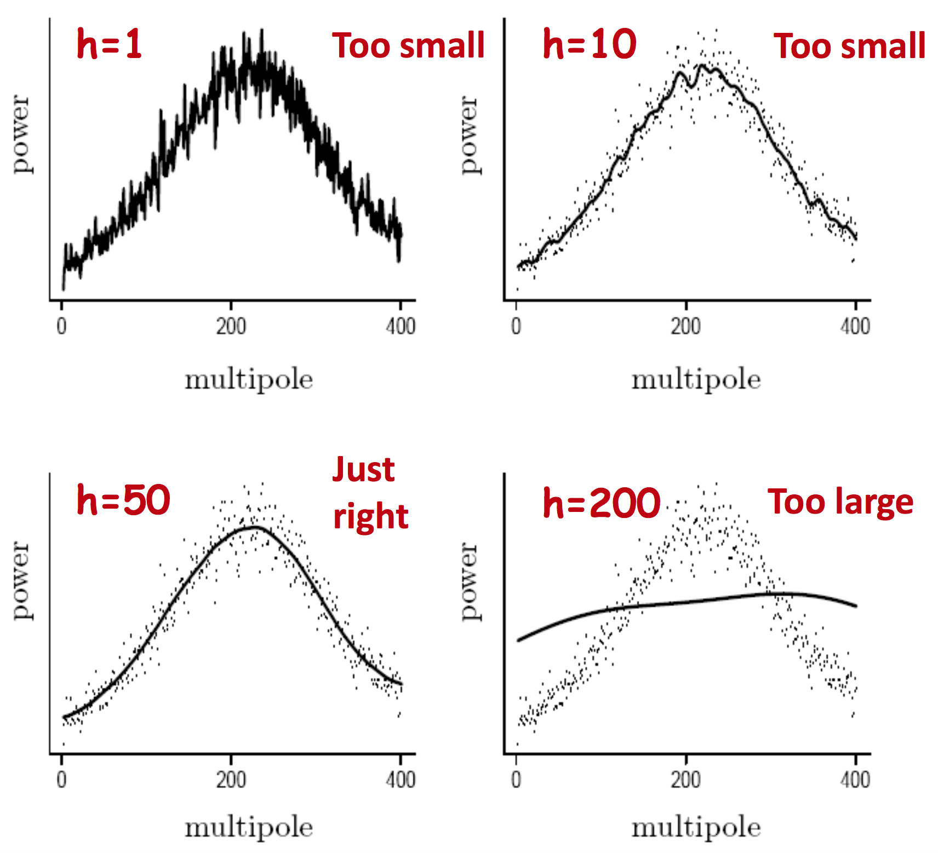
Choice of kernel bandwidth
Choice of kernel is not terribly important!

Slide 35



Kernel Regression as WLS
Weighted Least Squares (WLS) has the form
Compare to Nadaraya-Watson form
Kernel regression corresponds to locally constant estimator obtained from [locally] weighted least squares
Set where $β$ is constant

Slide 36



Kernel Regression as WLS
A constant value
Individual weights have to sum to 1

Slide 37
Summary
Nonparametric places mild assumptions on data; good models for complex data
Usually requires storing & computing with full dataset
Parametric models rely on very strong, simplistic assumptions
Once fitted, they are much more efficient with storage and computation
Effects of bin width & kernel bandwidth
Bias-variance trade-off
KNN classifier
Non-linear decision boundaries
Kernel regression
Comparison to weighted least squares

Slide 38
Questions?

Slide 39
Course Details
How is Assignment 5 going?
How are the projects going?
Workshop 8 on Autoencoders tomorrow!

Slide 40
References
“All of Nonparametric Statistics”, http://www.stat.cmu.edu/~larry/all-of-nonpar/index.html

